Slide 1


New York Life Application Services Outsourcing
TCS Transition Plan Overview
Copyright © 2015 Tata Consultancy Services Limited

Slide 2
Agenda| …aligned to your expectations
Plan for knowledge, people and process Transition
Transition Governance, Risk Management and Expectations from NYL
Summary
Transition Considerations, Approach and Methodology

Slide 3

Transition Considerations, Approach and Methodology

Slide 4
Our Robust Transition Framework| …designed for success
Key Considerations
Insurance and Agency
Corporate
Minimize disruption to Business
(Ensure BAU)
Product
Presales &
Marketing
Distribution
NB & UW
In-force
Client
Comm
Legal & Audit
Services
Compliance
Cultural Alignment to enable strategic partnership
Multi-location transition management through MasterCraft SAM
Application Support and Maintenance
Minor Enhancements (<80 hrs)
Testing Services
Small Enhancements (80 – 2000 hrs)
Effective Organizational Change Management and HR Solution to focus on the people impacted by new operating model
Risk Management
Establish NYL Academy for competency building & transition acceleration
Transition Program Management Office
Organizational Change Management & HR
Process & Tools Harmonization
Process & Tools Harmonization for successful move to Managed Services model
Knowledge Management
Building the Foundation for Successful Transformation to Managed Services Model

Slide 5
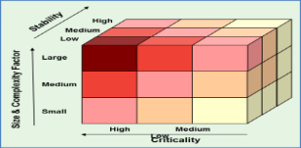

Integrated Transition Approach| …led by our Insurance domain knowledge
Step 1
Step 2
Step 3
Factors Studied
Multi Dimension Portfolio Analysis
Transition and OCM Plan
RFP Documents
Application Support / Maintenance
Grouping and Wave Definition
People dependency/structure
Functional & Tech grouping
Service locations
Process & tools standardization
Re-hiring plan
Application bundles
Business functions
Technology stack
Service delivery processes
Governance structure
People - Roles & responsibilities
Processes and tools
Business driven support events
DD Cube Assessment
Business criticality
Stability
Complexity / Size
Questions and Answers
Volume Metrics
Enhancements
Testing Services
Wave Planning
SME availability & free up
Transition cost
Operational feasibility
Existing processes
Existing Test processes maturity
Business Functions
Technology Stack
Similar business function
Niche technologies
OCM Planning
Application Inventory
ASM, Minor, Small Enhancements & Testing
10 bundles across I&AGT and corporate
587 systems (443 applications, 144 web services)
Transition duration for each application
12 months, 24 groups, 3 waves
Train the trainer approach
Process & people transition in alignment with overall plan
TCS DD Cube™ Framework as a structured approach for transition solution and planning

Slide 6
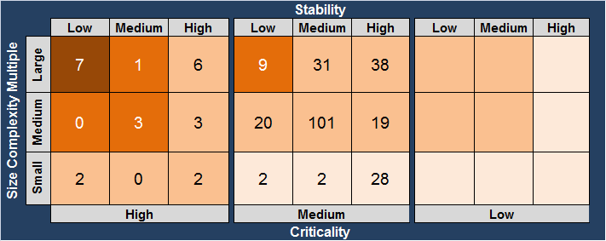
Transition Design| …an illustration of NYL Inforce bundle
Step 1
Step 2
Step 3
Factors Studied
DD CubeTM outcome
Transition Plan
274 systems
139 applications
135 Web Services
Description/Functions
Technology stack
Business criticality
Frequency of change
Complexity
Documentation availability
Business driven events
Application Grouping
Transition Duration
70 apps=8 wk, 65 apps =12 wk, 75 apps=16 wk, 64 app=20 wks
6 Groups, Wave 3, ~20 weeks
Apr14
May14
Jun15
Jul15
Aug15
70
65
30
45
14
50
AMS
Knowledge Transfer
Shadow Support
Reverse Shadow
QA
Knowledge Transfer
Capability Enhancement
Minor Enhancement Resource onboarding

Slide 7
Knowledge Transition Methodology| …guarded by jointly governed tollgates
Application Support and Maintenance
Planning
Knowledge Transfer
Secondary Support
Primary Support
Steady State
Refine scope, staffing needs, prepare detailed transition plan & collect documents
Understand existing environment, process and procedures
Hands on experience with limited SME involvement
Handle services with minimal to no support from SMEs
Provide services independently subject to SLAs and continuous improvement
Partial Work Ownership
Work Ownership
Refined DoU, SOPs
Identify/address gaps
Perform critical tasks
Approved DoU, SOPs
Go Live readiness
3
Testing
Study Environment
Acquire Knowledge
Capability Enhancement
SLA based services
Project Plan
Defined volume
metrics
Documentation
assessment
Draft standard
operating procedures
Update existing
documentation
Playback sessions
Induction manuals
Hands on experience by ‘Shadowing’ NYL staff and assume responsibility for service with NYL staff on standby
SLA reporting
Work Ownership
Test case creation, execution and reporting
1
2
4
Toll Gate
Toll Gate
Toll Gate
Toll Gate
Life Cycle of a Phase (ETVX)

Slide 8
Testing Shared Services Center (TSSC) Transition
TSSC Knowledge Acquisition
TSSC Enhancement
Test
Automation
Automation Standards & Processes
Automation Framework & Tools used
Customer In-house tools used
Perform dry-runs and execute Automation test packs
Conduct playback sessions & obtain signoff
Maintain and enhance existing Automation suites
Performance & Other Non-Functional Testing
Business Volume Metrics
Performance & Monitoring Tools
Mainframe batch timeline / capacity planning mechanism
Create test stubs in QA environment
Implement and monitor performance tools
Play back sessions & obtain signoff
Test Data Management
Test Data Management processes
Understand the data models
Understand data capture process and data dependency across platform
Data mining / creation process
Data obfuscation and sub-setting process
Conduct play back sessions and obtain sign off
Test Environment Management
Understand environment topology
Understand triaging mechanism
Understand Dev / test environment dependency across releases
Proactive monitoring and health checks / query catalog
Collaboration with infrastructure / release / configuration
Conduct play back sessions and obtain sign off

Slide 9

Plan for knowledge, people and process transition

Slide 10

Integrated Transition Plan| …holistic plan covering all bases
APR15 | MAYL15 AUG15 | Sep15 | Oct15 | Nov15 | Dec15 | Jan16 | Feb16 | Mar16 | Apr16 | May16 | Jun16 | Jul16 | Aug16
Apr15
May-
Jul 15
Aug15
Bundles
Application Groups
Due Diligence
Contract Finalization
Transition Planning (Link / ODC Setup)
Freeze
Freeze
Insurance and Agency
Product
1. Product
4
Presales
1. Mkting & Lead Mgmt ; 2. Fin Planning, Illustrations
22
1. Peripheral apps ; 2. All Other apps
3. Agent comp & perf mgmt ; 4. L&A, services, others
30
Distribution
1. Other peripheral apps
2. Life ; 3. Annuity ; 4. Other core apps
53
16
NB & UW
27
1. Client/contract/producer services
2. Other services
3. Peripheral apps ; 4. Life apps
5. Billing, collections, accounting ; 6. All other apps
70
In-force
WAVE 1
65
75
64
Corporate
Legal & Audit
1. Legal & Audit
8
Services
1. Services
WAVE 2
17
WAVE 3
Client
1. Client
17
1. Group 1
2. Group 2
17
Compliance
16
Communication
1. Lotus notes apps ; 2. All other apps
85
Knowledge Transfer
TSSC Transition
Service phase -TSSC
AMS
Shadow Support
Process Transition
Transition -TSSC
Reverse Shadow
People Transition
Assess, Define
Measure, Refine
QA
Knowledge Transfer
Capability Enhancement
Tools Configuration
Minor Enhancement Resource onboarding
OCM
Re-hiring
Process Deployment

Slide 11
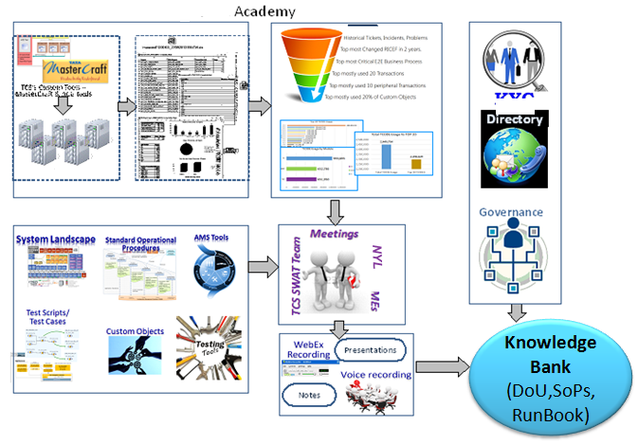
Knowledge Management | …formation of NYL Academy
Define and rollout a robust KM strategy for NYL during Transition
Use knowledge transfer Phase for consolidating & creating foundation elements for NYL knowledge bank (Document of Understanding, SoP, Run Book, Knowledge Articles)
Leverage TCS Tools for accelerated understanding of NYL Technical landscape (MasterCraft TM Application Analyzer)
Continued use and Lifecycle maintenance of Knowledge Bank
Skilled core team: Tool based analysis: knowledge base readiness : Accelerated Transition

Slide 12





People Transition | …full integration with TCS family
Due Diligence
Skill & role mapping, Benefits Comparisons, Communication & Transition plan
Communication
TATA Brand awareness, Collaborative Messages, one-on-one meets, Role Discussions
Key Driving Factors for
Re-hiring
Knowledge Retention
Local Support
Regulatory requirements
Risk Mitigation
People Transition
Offer roll out, Implement retention plans, Welcoming Employees
Orientation & Induction
TATA Process Induction, Building a comfort zone, Knowledge Transfer
Integration
Personalized Integration plan, Consistent HR Interventions, Competency up-skill

Slide 13
Process and Tools Transition | …backbone of managed services model
Cross Functional Processes
Key Activities
ASM Processes
Incident and Problem Management
Service Request Management
Change and Release Management
Configuration Management
Event Management
Availability Management
Performance Management
Knowledge Management Process
IT Service Continuity Mgmt
Supplier Management
Service Level and Reporting
Assess
Maturity Assessment of existing ASM and Testing processes (Leveraging TCS TIARATM Framework) and tools
Refine
Roadmap of process maturity with potential service improvements aligned with future state model
Integrate
Development of process interface and data points for effective operations
Train
Conduct role-based awareness training programs
Testing Processes and Tools
Readiness assessment for new service delivery and operations procedures with support from Transition PMO
Readiness
Test Management
Test Processes and Tollgates
Test Automation
Non-functional testing
Test Environment Management
Test Data Management
Rollout
Rollout of the processes and re-configured tools across the organization based on the deployment plan
Process assessment will be an important task to move into the new service delivery model

Slide 14
Organization Change Management | …supported by TCS
Pre -Transition
Transition
Transformation
Phases
Due Diligence
Project Start-Up
Knowledge
Transfer
Pilot
Steady State Maintenance
Transform
Milestone achievement communiqués and conduct town hall meetings
Create & orient joint OCM team
Perform Change Impact Assessment & Role Mapping
Conduct changed process dipstick survey & take corrective actions
Establish Standard Operating Procedure
Align Leaders to Transformed End state
Refine OCM scope
Create Communication Strategy & Plan
Create Competency Development Plan
Build Awareness -WIIFM(what’s in it for me)
Start Change History & Readiness Assessment
Build
awareness: Vision & Roadmap
Ensure Continuous improvement
Rollout Training across impacted Retained IT workforce
Facilitate Workshops with key Bundle/ Service Owners
Perform Performance
evaluation
Conduct Executive Case for Change workshops
Facilitate Cultural Integration
Organization Change Management
Communicate Rewards and Recognition Plan
Rollout Post Transition Communications
Establish Change Champion Network
Prepare Sustenance and Benefits Roadmap
Identify Key Risks and Opportunities
Communicate Process Changes and Benefits
Outline OCM Strategy & Plan
Create Role based Training Strategy and Plan
Understand further Training needs
Hand-over to NYL OCM team
Monitor & Improve Workforce Effectiveness
Stakeholder Engagement / Resistance Management
OCM activities closely coupled with Transition and Program Management activities

Slide 15
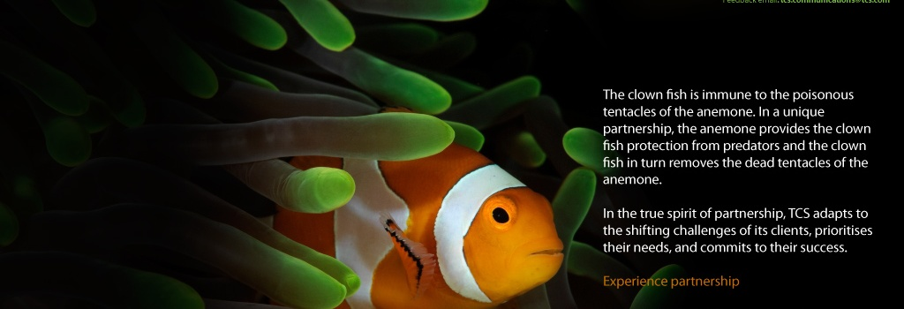
Transition Governance, Risk Management and Expectations from NYL

Slide 16
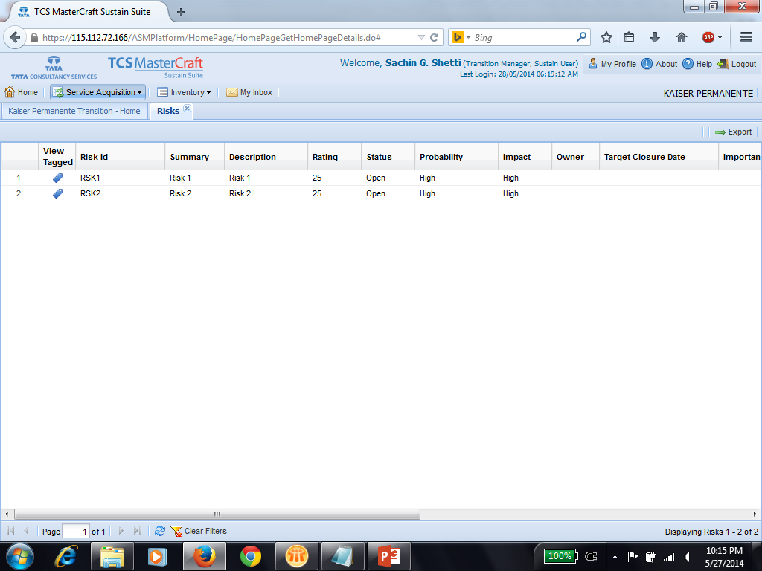
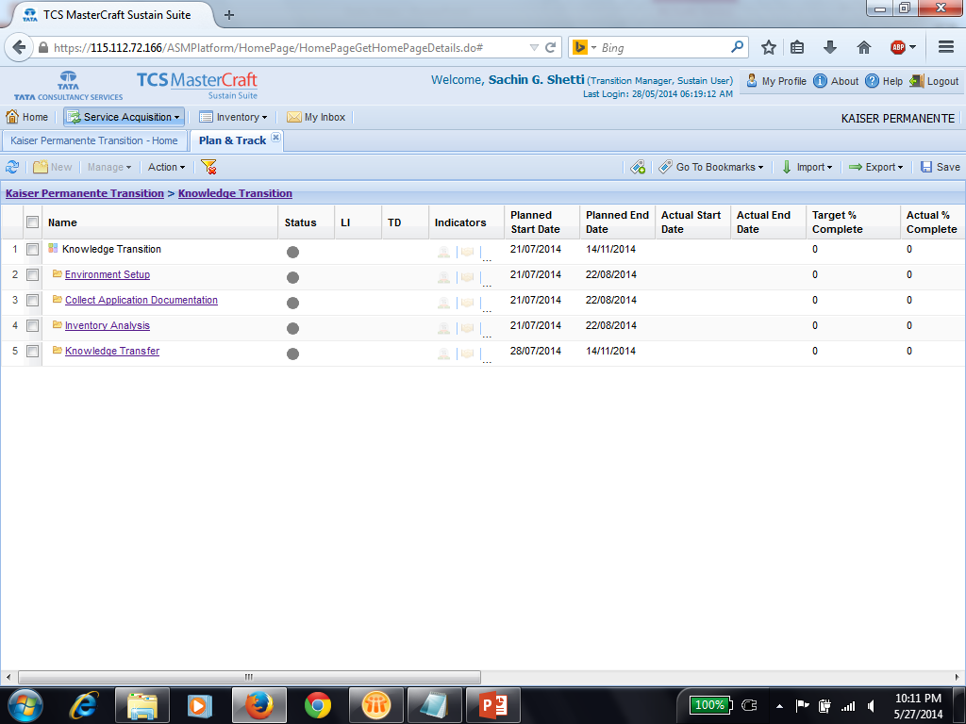
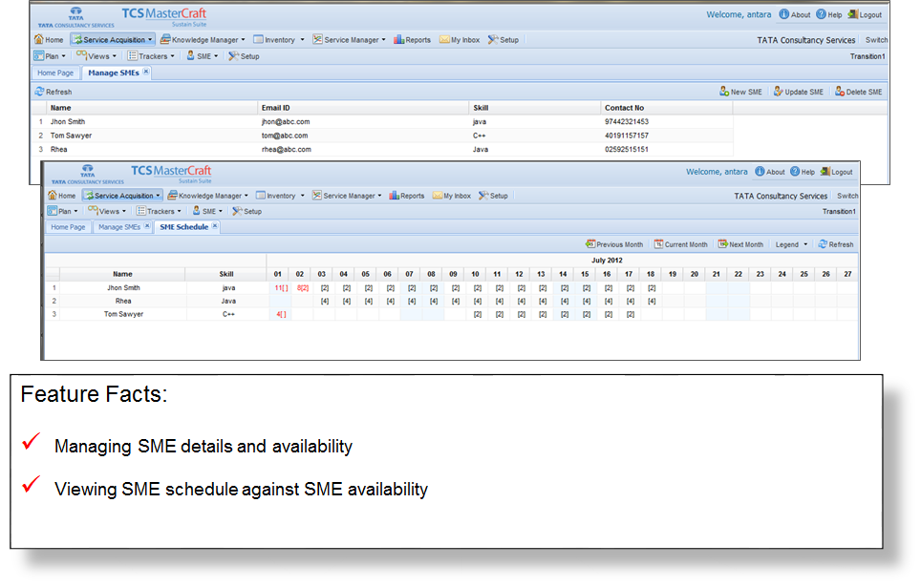
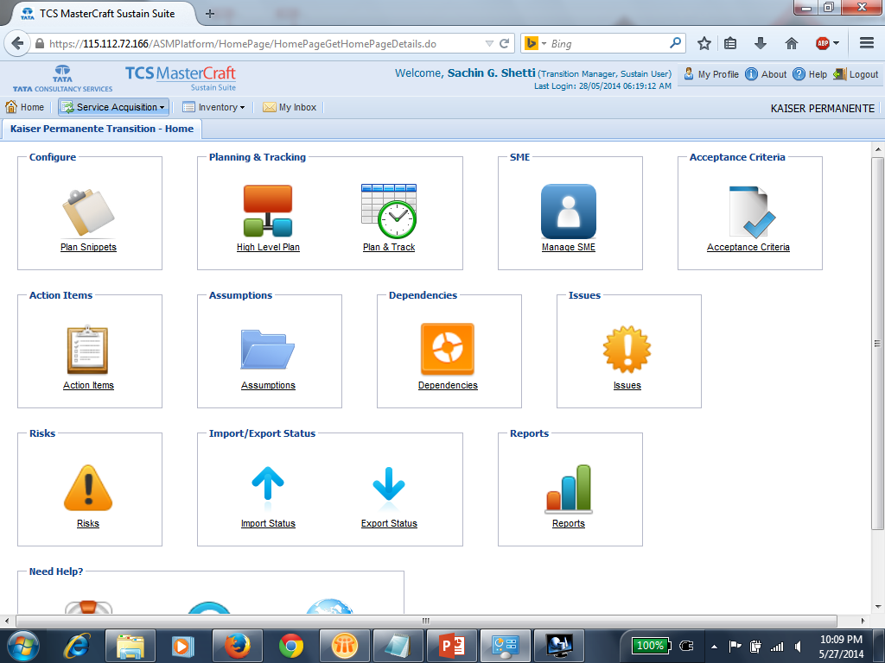
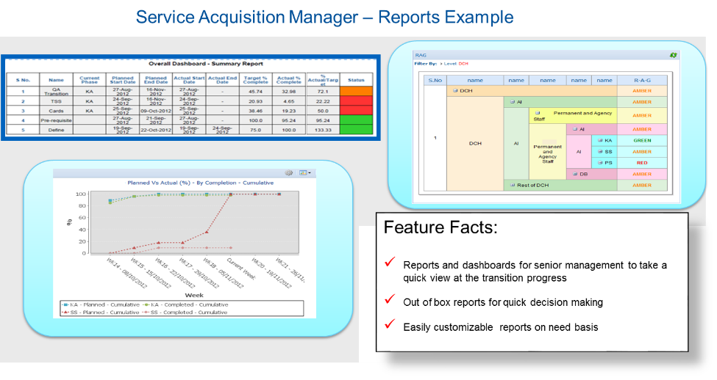
Transition Governance | …digitized transition management
Demo
Demo
Demo
Home
Demo
Home
Home
Demo
Demo

Slide 17
TCS Tools and Accelerators| …we are committing to leverage our assets
MasterCraftTM Service Acquisition Manager
Digital transition management and governance
TIARA Framework for Test Maturity
Organization testing process maturity assessment
MasterCraftTM Application Analyzer
Reverse engineering tool for Cobol, Java and VB applications
Transition Tool Kit
One-shop portal for all transition & delivery assets for standard templates and checklists

Slide 18
Risk Management| …reality check and what we need to prepare for
Risk | Severity | Mitigation Strategies
Unplanned exit of incumbent/contractors/FTEs | High | Prioritize areas with high contractor ratio Joint planning for re-hiring key SMEs Early communication to retained organization for future roles
Limited SMEs availability | High | Use alternate methods like documentation & TCS tools to acquire knowledge Book SME calendar in advance during planning
Non-cooperation from SMEs | High | Escalate issues at appropriate levels Implement OCM initiative to establish change champion network
Cultural Differences | High | Cross-cultural workshops
Limited documentation | High | Use MasterCraftTM application analyser to acquire knowledge
Process deployment/infrastructure delay | High | Dedicated process transition work stream Applications & tools access assessment during due diligence
Unplanned exit of TCS personnel | Medium | Establish NYL Academy to capture knowledge, build cross-trained team
Insufficient work volume during shadow | Medium | Mock up scenarios Qtr/Year end processing in QA environments

Slide 19
Expectations From NYL| …you have an important role to play
Involvement During Transition Execution
Role | Key Activities | Time Commitment
NYL executive leadership | Weekly/fortnightly executive steering committee meeting Transition performance & health check Customer Satisfaction Metrics | 2 hours per meeting
NYL managers Transition manager | Daily/weekly transition progress review meetings Transition Health Check Transition risks & mitigation status | 5-10 hour per week
NYL SMEs | Transition sessions as per plan Review daily issues (critical/high, medium) | 10-15 hrs./week for KT 10 hrs/week for shadow phases
Other Key Asks
Communication to IT & business on ‘what to expect’
A single point of contact Transition manager
Availability of required SMEs during transition
Inputs , validation and sign-off during planning
Participate in process harmonization workshops
Enable firewall, app access & connectivity etc. for ODC setup

Slide 20

In Summary…

Slide 21
Our Transition Success Levers| …we are well equipped
Integrated Transition Approach
Risk Mitigated Transition
Transition Management Office
Best-in-class Tools, Assets and Accelerators
Domain-Led Transition

Slide 22
Appendix

Slide 23
Alternate Integrated Transition Plan| …holistic plan covering all bases
Apr15
May-
Jul 15
Aug15
Sep15
Oct15
Nov15
Dec15
Jan16
Feb16
Mar16
Apr16
Bundles
Application Groups
Due Diligence
Contract Finalization
Transition Planning (Link / ODC Setup)
Freeze
WAVE 2
Insurance
Product
1. Product
4
Presales
1. Mkting & Lead Mgmt ; 2. Fin Planning, Illustrations
22
1. Peripheral apps ; 2. All Other apps
3. Agent comp & perf mgmt ; 4. L&A, services, others
30
Distribution
53
WAVE 3
1. Other peripheral apps
2. Life ; 3. Annuity ; 4. Other core apps
16
NB & UW
27
1. Client/contract/producer services
2. Other services
3. Peripheral apps ; 4. Life apps
5. Billing, collections, accounting ; 6. All other apps
70
WAVE 1
In-force
65
75
64
Corporate
Legal & Audit
1. Legal & Audit
8
Services
1. Services
17
Client
1. Client
17
1. Group 1
2. Group 2
17
Compliance
16
Communication
1. Lotus notes apps ; 2. All other apps
85
Knowledge Transfer
TSSC Transition
AMS
Shadow Support
Process Transition
Transition phase -TSSC
Service phase -TSSC
Reverse Shadow
People Transition
Assess, Define
Measure, Refine
QA
Knowledge Transfer
Capability Enhancement
Tools Configuration
Minor Enhancement Resource onboarding
OCM
Re-hiring
Process Deployment

Slide 24
Thank You!

